Slide 1
Foreign Direct Investment and Technology Spillovers: Theory and Evidence
Zhiqiang Liu
University of Southern California
Bruno Ascencio

Slide 2
Objective
The purpose of this paper is to offer an explanation on how FDI generates externalities (technology transfer)
Distinguish between level and rate effects of spillovers over productivity
Analyze different effects in the short-term and the long-term
Measure the impact of the spillovers over forward and backward linkages

Slide 3
Introduction
Attracting FDI has become essential part of development strategies
Domestic firms can learn from foreign-invested firms by:
observation
business relations
labor turnover
Empirical evidence on whether FDI facilitates technology spillovers is ambiguous
Study | Country | Results
Germidis (1977) | Various LDC | No evidence of technology transfer from foreign to local firms
Aitken and Harris (1999) | Venezuela | FDI affects adversely the productivity of domestic firms. “Market stealing”
Liu (2002) | China | Large and significant impact of FDI over productivity of domestic firms
Javorcick (2004) | Lithuania | Positive productivity spillovers from foreign firms to local suppliers

Slide 4
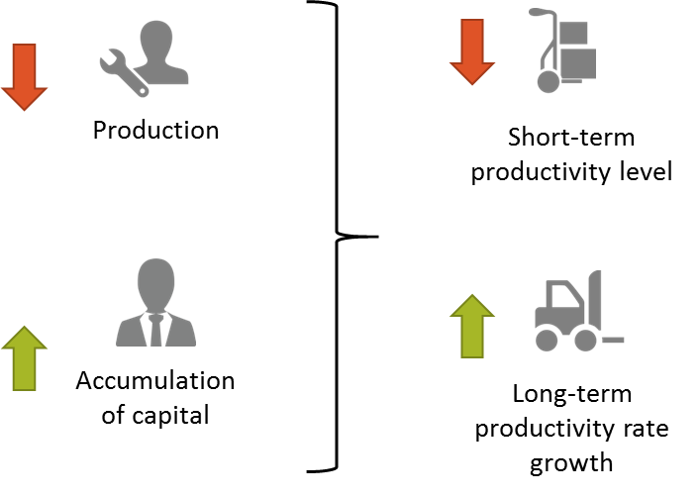
Introduction
An increase in the stock of public knowledge leads firm to change optimal allocation of managerial time
While there is suggestive evidence for intra industry or horizontal spillovers, backward linkages seem to be statistically the most important channel through which technology spills over from foreign to domestic firms

Slide 5
Methodology
The empirical analyses in this study are based on a sample of manufacturing firms in China
Unbalanced panel consisting of 17,675 manufacturing firms over a period of 5 years from1995 to 1999 with a total of 50,667 observations
Total of 17 equations based on the following:
Equation (1) firm’s production function
Equation (2) firm’s specific capital
Equation (3) Total factor productivity at the time t
Equation (4) Growth rate of total factor productivity
Equation (5) Steady state growth rate of firm-specific capital
Equation (6) Logarithm of firm productivity (inter and intra industry effects)
Equations

Slide 6
Main Results
(-) effects over productivity level of intra industry firms (short-term)
(+) effects over productivity rate of intra industry firms (long-term)
(+) estimated rate effect of backward spillovers (inter industry)
Not significant estimated rate effect of forward spillovers (inter industry)

Slide 7
Main Results
According to these estimates, the increase in the rate of productivity growth will enable the affected firms to recover the initial loss in the productivity level in about 3 years, and thereafter the net effect of spillovers is positive and growing over time

Slide 8
Conclusion
For FDI to promote long-term economic growth, it must lead the recipient country to adopt policies that are conducive to economic growth or policies that facilitate technology transfer
An increase in FDI in the industry at the four-digit level lowers the short-term productivity level but raises the long-term rate of productivity growth of domestic firms
The latter dominates the former in the long run and domestic firms benefit from the presence of FDI in their industries
Backward linkages are statistically the most important channel through which technology spills over from foreign-invested to domestic firms

Slide 9
Remarks
If positive effects are permanent, while the negative effects are transitory, then as unprofitable firms exit, the negative productivity effects could decline
The latter works against local firms (“crowding out”)
Spillovers are not automatic, in the case of local suppliers, they require government policies that help local firms adapt to new demand

Slide 10
Foreign Direct Investment and Technology Spillovers: Theory and Evidence
Zhiqiang Liu
University of Southern California
Bruno Ascencio

Slide 11
Appendix

Slide 12
Equations
A = exogenous technical factors
B = productivity parameter
L = Labor
K = Capital
H = Stock of firm specific capital
M = Fraction of Managerial time devoted to production
G = Public information on tech and management methods

